Slide 1
HTML & CSS
Desarrollo tecnológico y Web

Slide 2
Today
Intro HTML
How Pages Use Structure HTML
Tags
Text body head
List
Links
Intro CSS

Slide 3
HTML
You may know that HTML stands for HyperText Markup Language.
The HyperText part refers to the fact that HTML allows you to create links that allow visitors to move from one page to another quickly and easily.
A markup language allows you to annotate text, and these annotations provide additional meaning to the contents of a document.
If you think of a web page, we add code around the original text we want to display and the browser then uses the code to display the page correctly. So the tags we add are the markup.

Slide 4
How Pages Use Structure
In all kinds of documents, structure is very important in helping readers to understand the messages you are trying to convey and to navigate around the document. So, in order to learn how to write web pages, it is very important to understand how to structure documents.
Think about the stories you read in a newspaper: for each story, there will be a headline, some text, and possibly some images. If the article is a long piece, there may be subheadings that split the story into separate sections or quotes from those involved. Structure helps readers understand the stories in the newspaper.
● See how HTML describes the structure of a web page
● Learn how tags or elements are added to your document
● Write your first web page

Slide 5
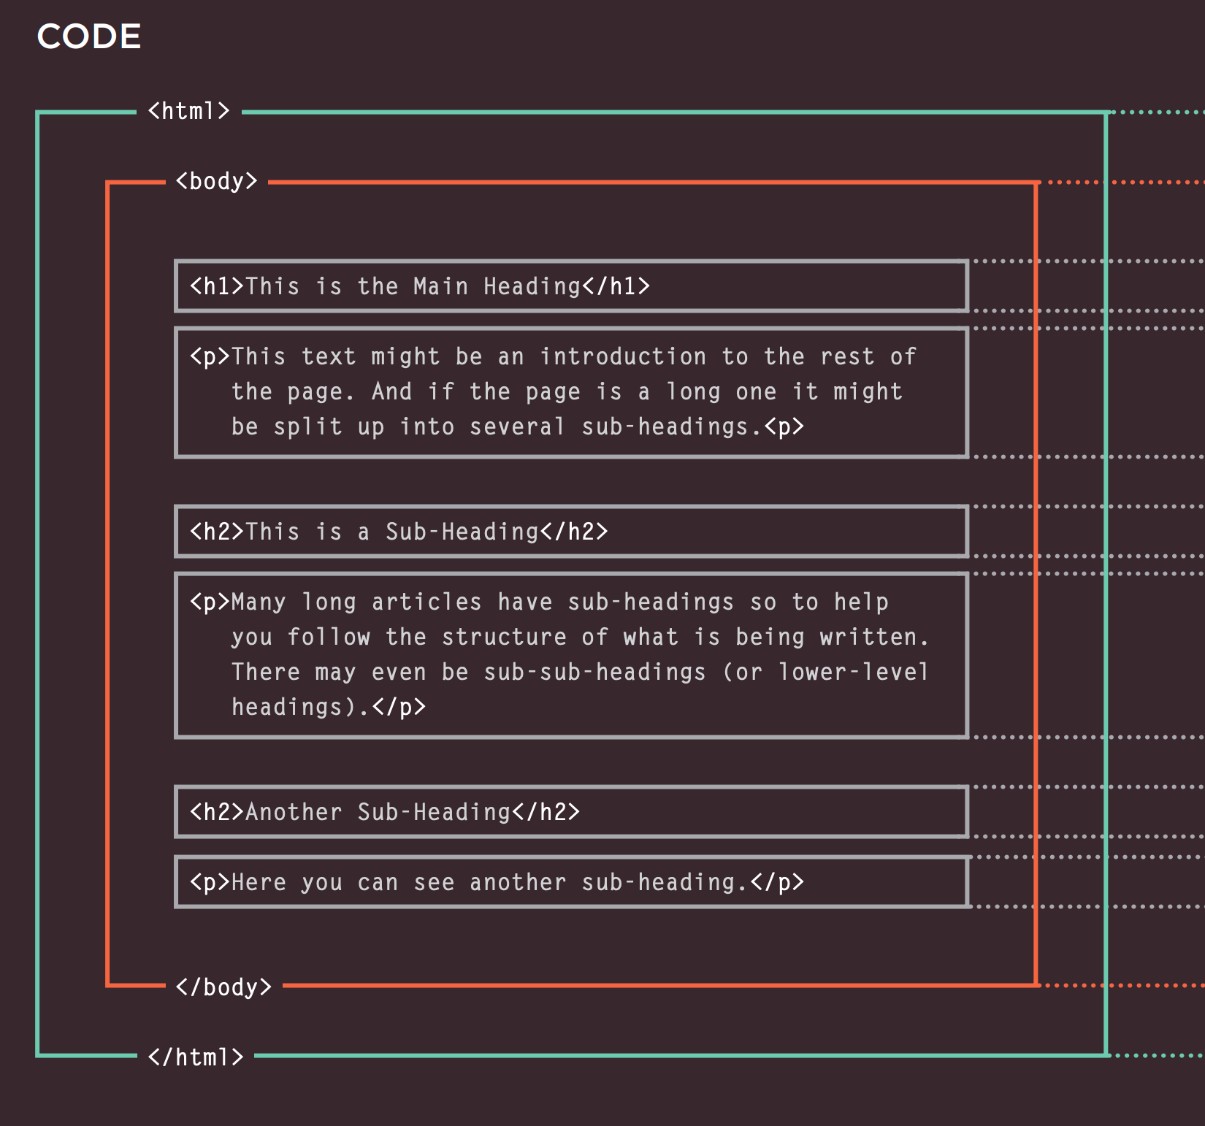
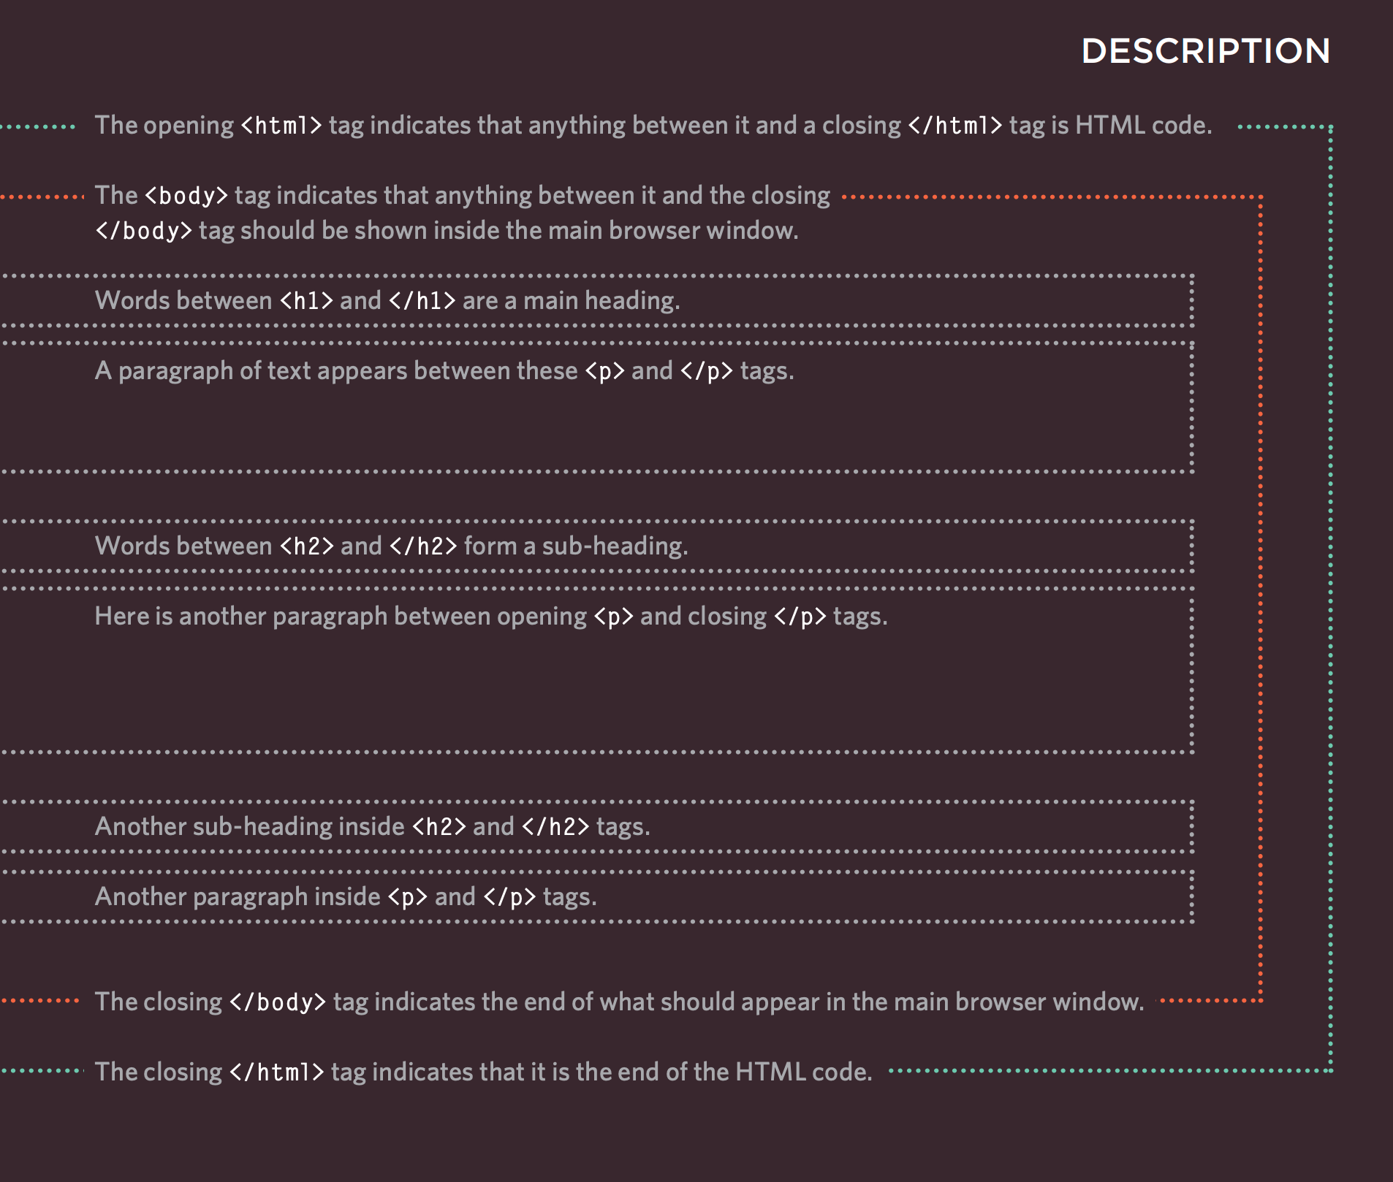

Slide 6
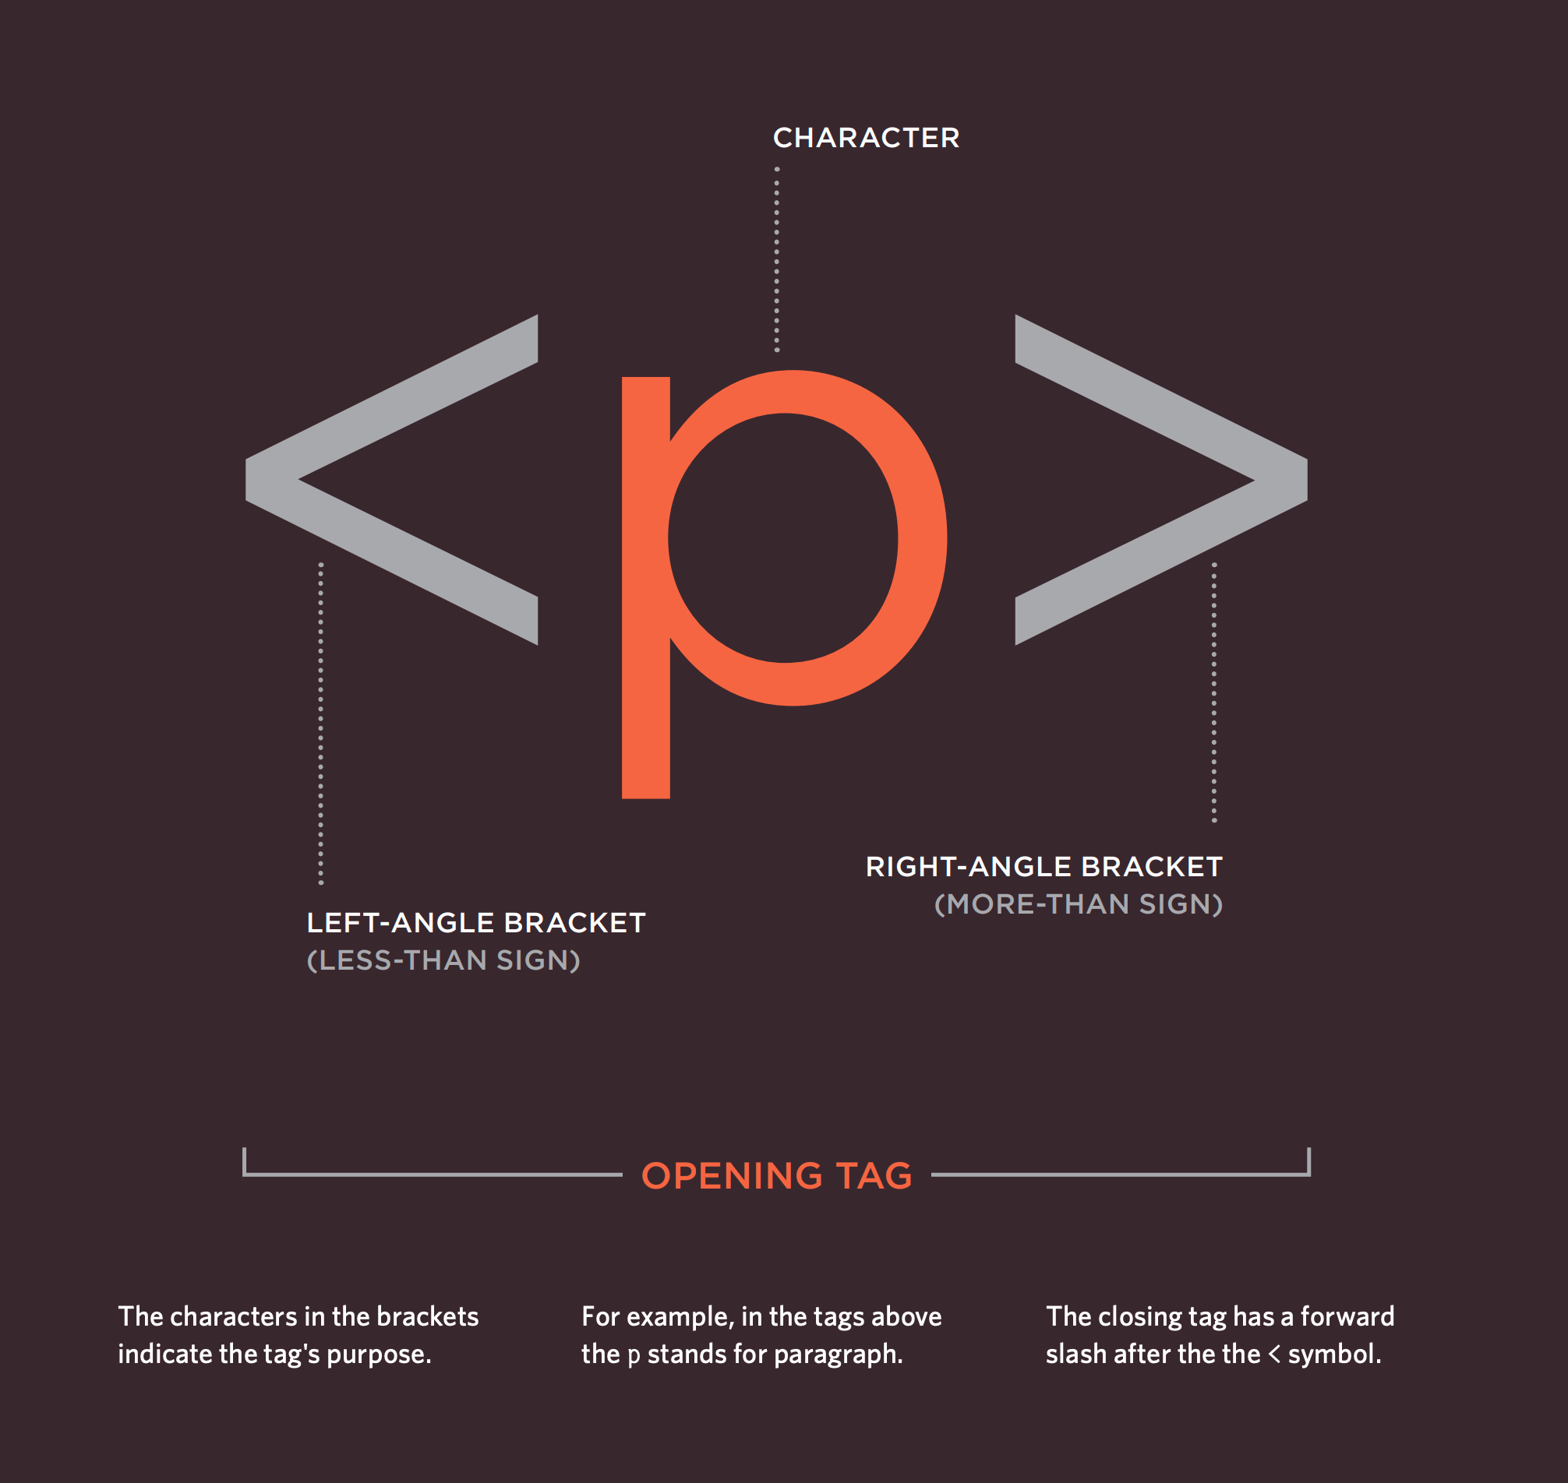
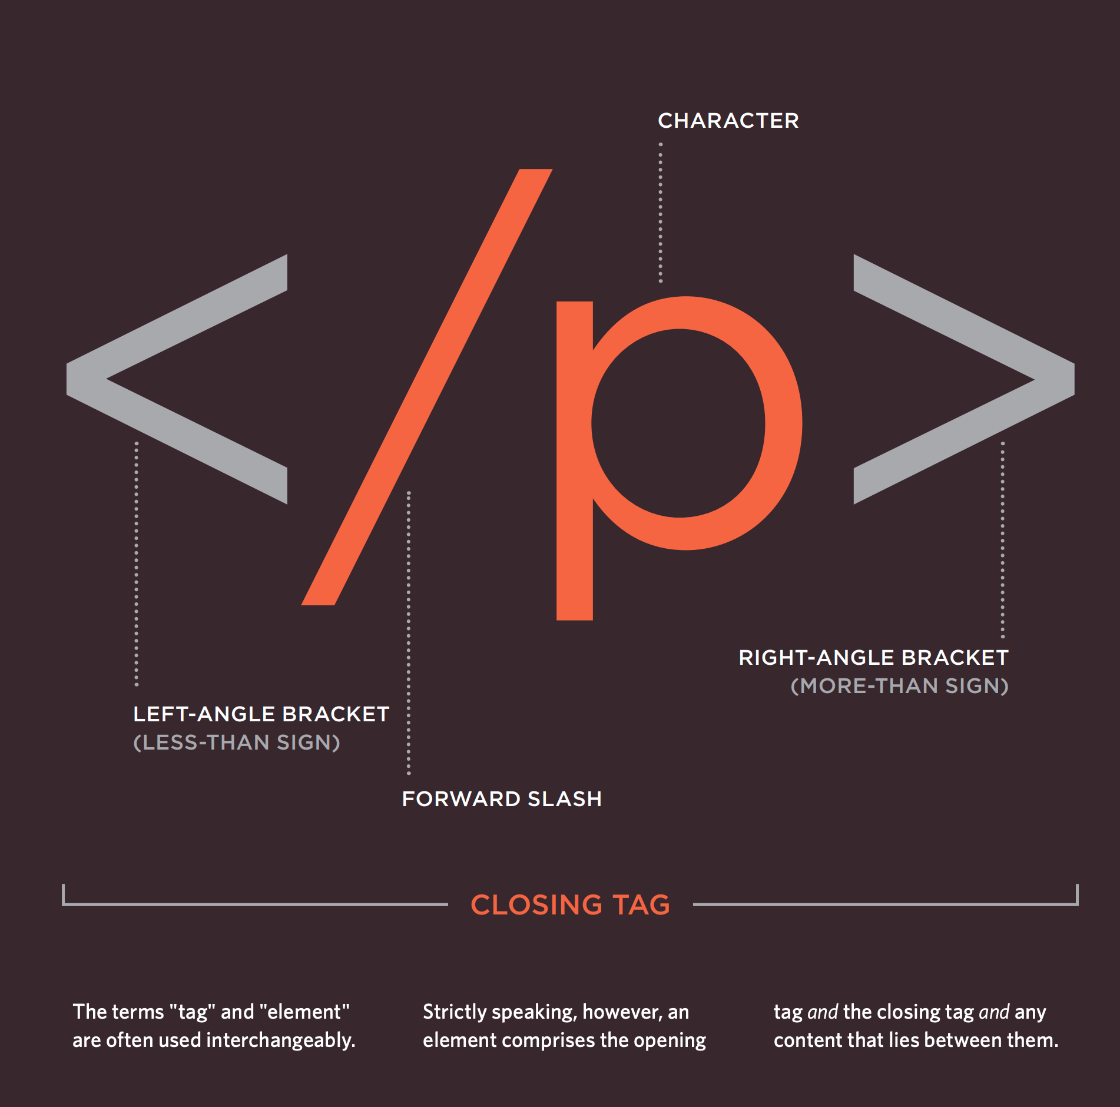
A Closer Look at Tags

Slide 7
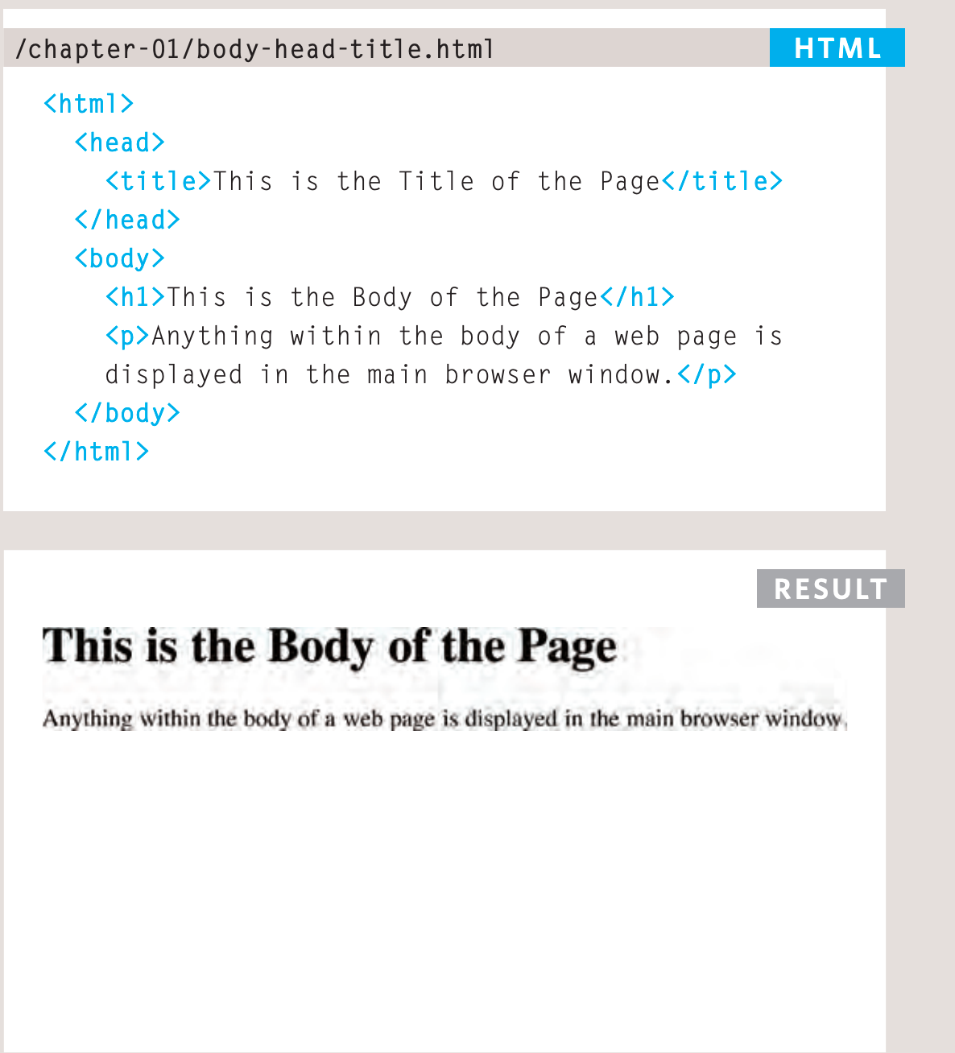
Text Body, Head & Title
You met the <body> element in the first example we created. Everything inside this element is shown inside the main browser window.
Before the <body> element you will often see a <head> element. This contains information about the page (rather than
information that is shown within the main part of the browser
window that is highlighted in blue on the opposite page).
You will usually find a <title> element inside the <head>
element.
The contents of the <title> element are either shown in the
top of the browser, above where you usually type in the URL of the page you want to visit, or on the tab for that page (if your browser uses tabs to allow you to view multiple pages at the same time).

Slide 8
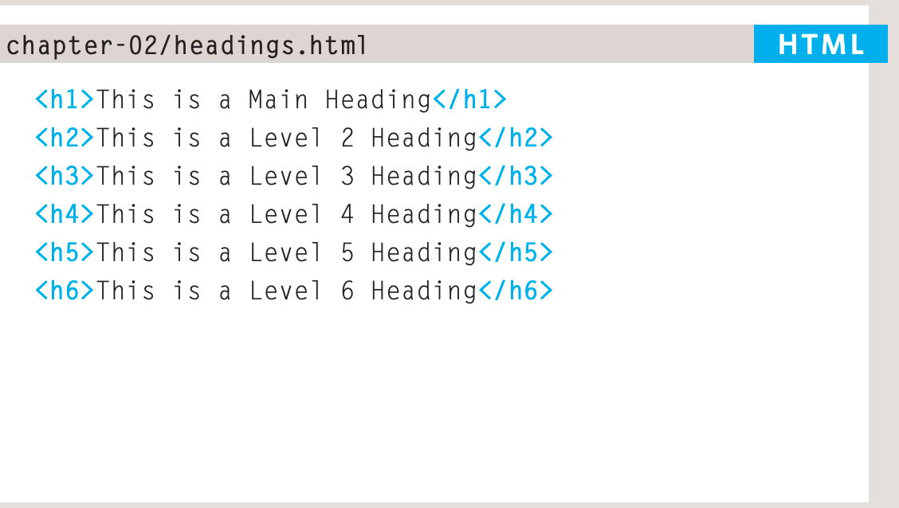
Headings
HTML has six "levels" of headings:
<h1> Is used for main headings
<h2> is used for subheadings
If there are further sections under the subheadings then the
<h3> element is used, and so on...

Slide 9
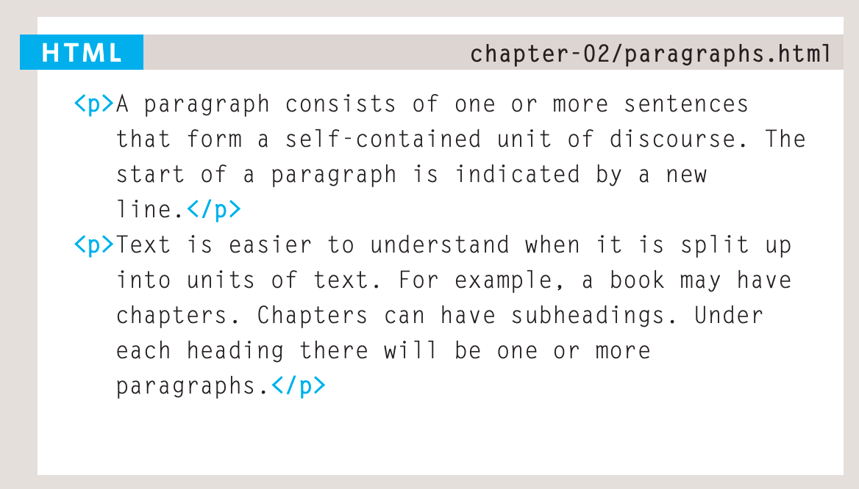
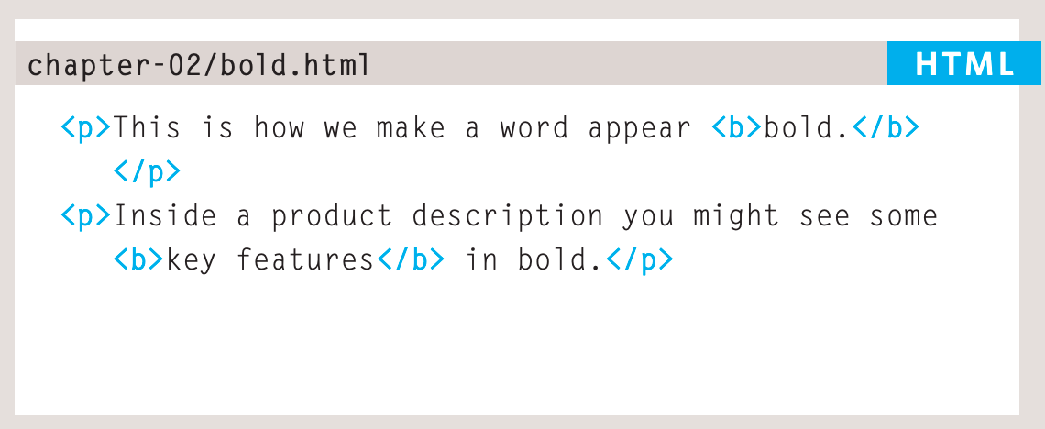
Paragraphs & Bold
To create a paragraph, surround the words that make up the paragraph with an opening <p> tag and closing </p> tag.
By enclosing words in the tags <b> and </b> we can make characters appear bold.

Slide 10
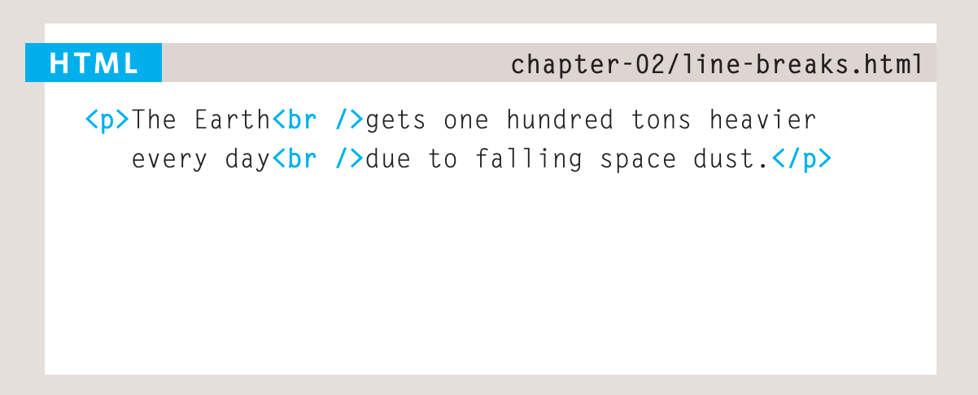
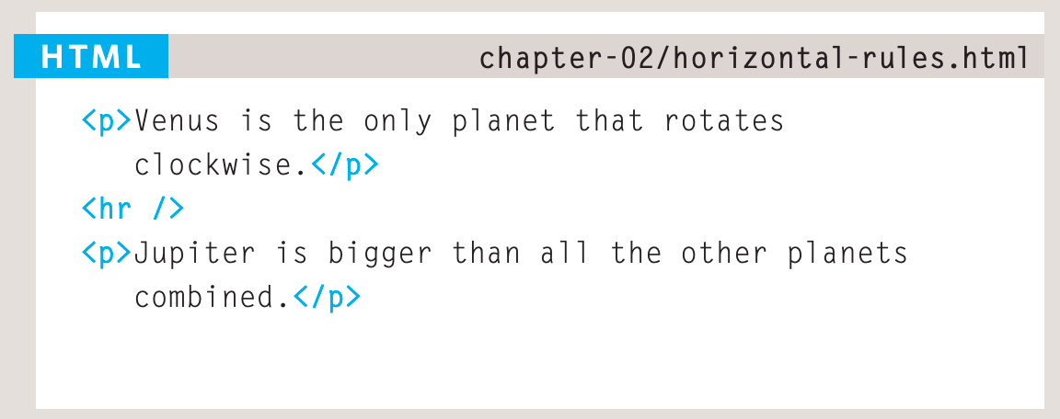
Line Breaks & Horizontal Rules
If you wanted
to add a line break inside the
middle of a paragraph you can
use the line break tag <br />
To create a break between themes — such as a change of topic in a book or a new scene in a play — you can add a horizontal rule between sections using the tag.

Slide 11
Lists
HTML provides us with three different types:
● Ordered lists are lists where each item in the list is numbered. For example, the list might be a set of steps for a recipe that must be performed in order, or a legal contract where each point needs to be identified by a section number.
● Unordered lists are lists that begin with a bullet point (rather than characters that indicate order).
● Definition lists are made up of a set of terms along with the definitions for each of those terms.

Slide 12
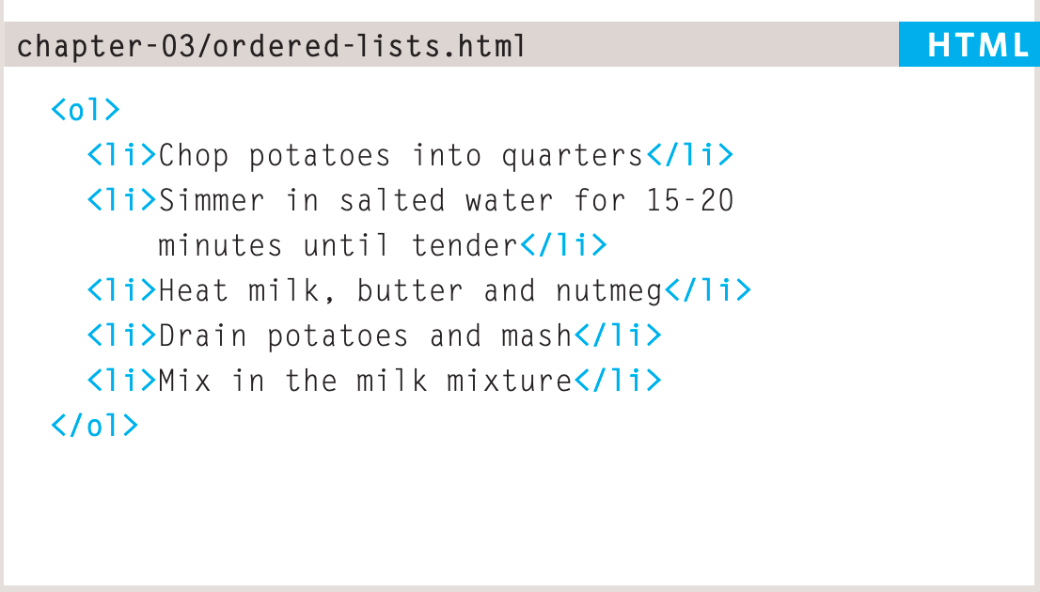
Order Lists
The ordered list <ol> is created with the element.
Each item in the list is placed between an opening <li> tag and a closing </li>
tag. (The li stands for list item.)

Slide 13
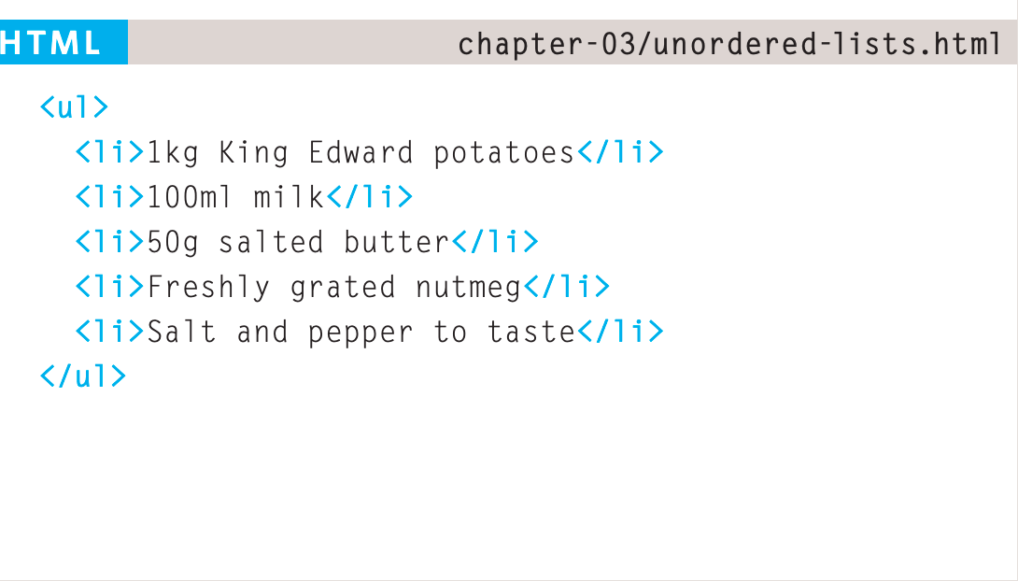
Unordered Lists
The unordered list is created with the <ul> element.
Each item in the list is placed between an opening <li> tag and a closing </li>
tag. (The li stands for list item.)

Slide 14
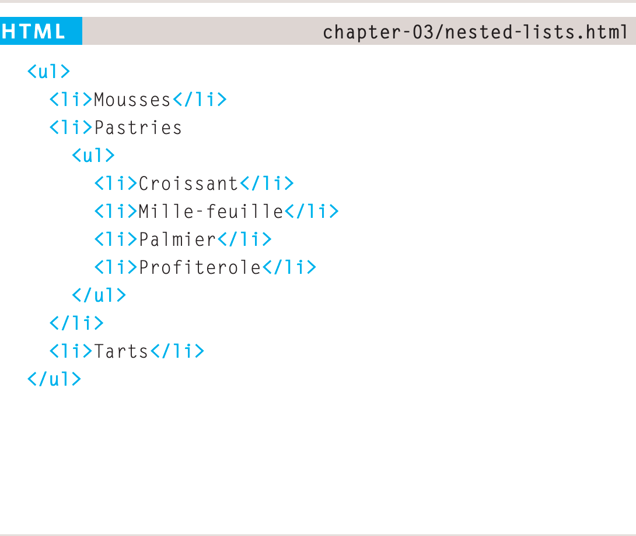
Nested Lists
You can put a second list inside an <li> element to create a sublist or nested list.

Slide 15
Links
Links are the defining feature of the web because they allow you to move from one web page to another — enabling the very idea of browsing or surfing.
You will commonly come across the following types of links:
● Links from one website to another
● Links from one page to another on the same website
● Links from one part of a web page to another part of the same page
● Links that open in a new browser window
● Links that start up your email program and address a new email to someone

Slide 16
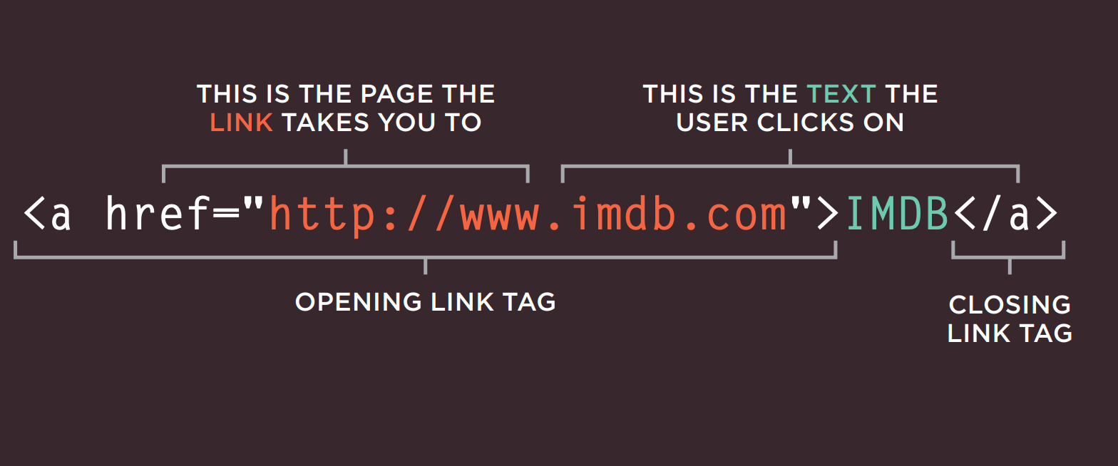
Links
Links are created using the <a> element. Users can click on anything between the opening <a> tag and the closing </a> tag. You specify which page you want to link to using the href attribute.

Slide 17
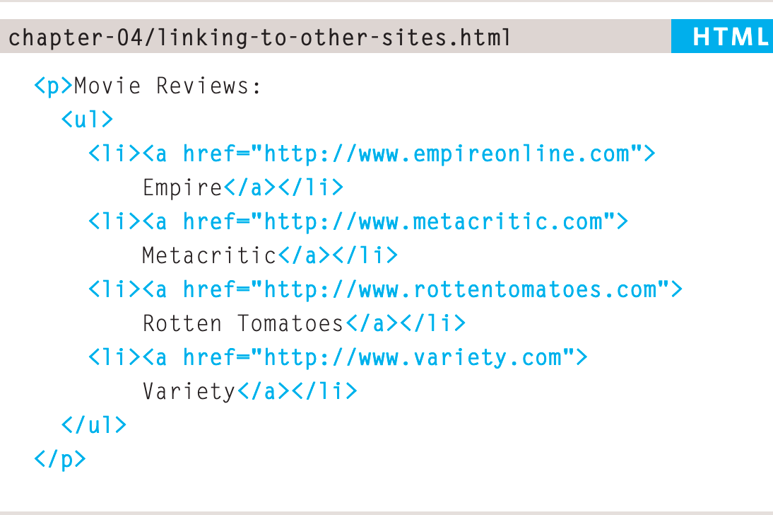
Links
When you link to a different website, the value of the href attribute will be the full web address for the site, which is known as an absolute URL.
ABSOLUTE URLS
URL stands for Uniform Resource Locator. Every web page has its own URL. This is the web address that you would type into a browser if you wanted to visit that specific page.
An absolute URL starts with the domain name for that site, and can be followed by the path to a specific page.

Slide 18
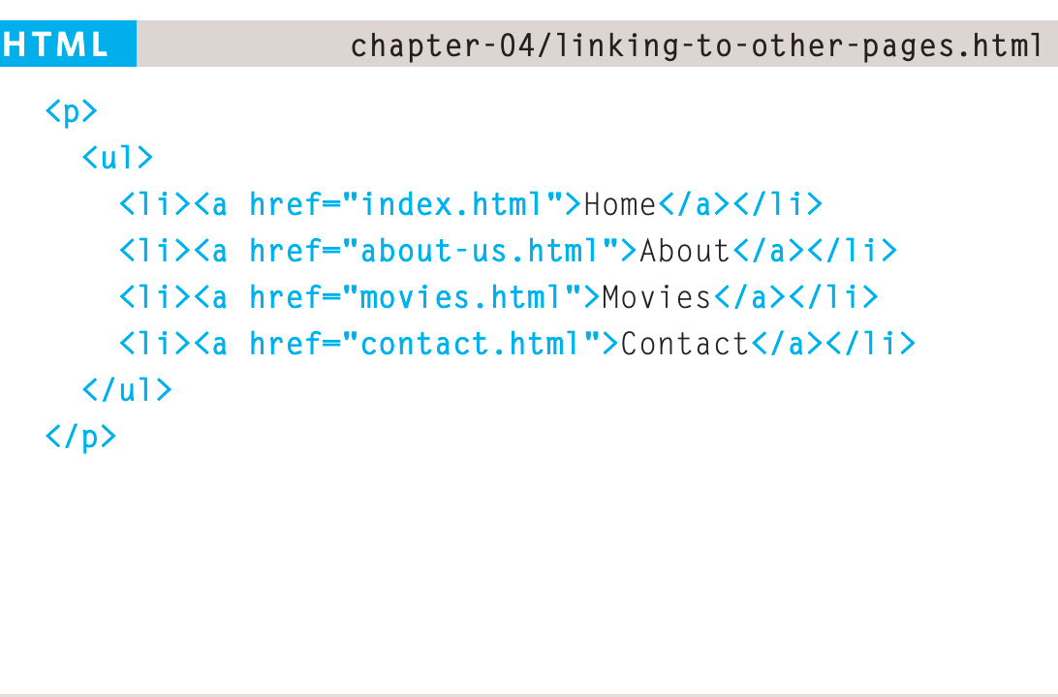
Links
When you are linking to other pages within the same site, you do not need to specify the domain name in the URL. You can use a shorthand known as a relative URL.
Relative URLS
When linking to other pages within the same site, you can use relative URLs. These are like a shorthand version of absolute URLs because you do not need to specify the domain name.

Slide 19
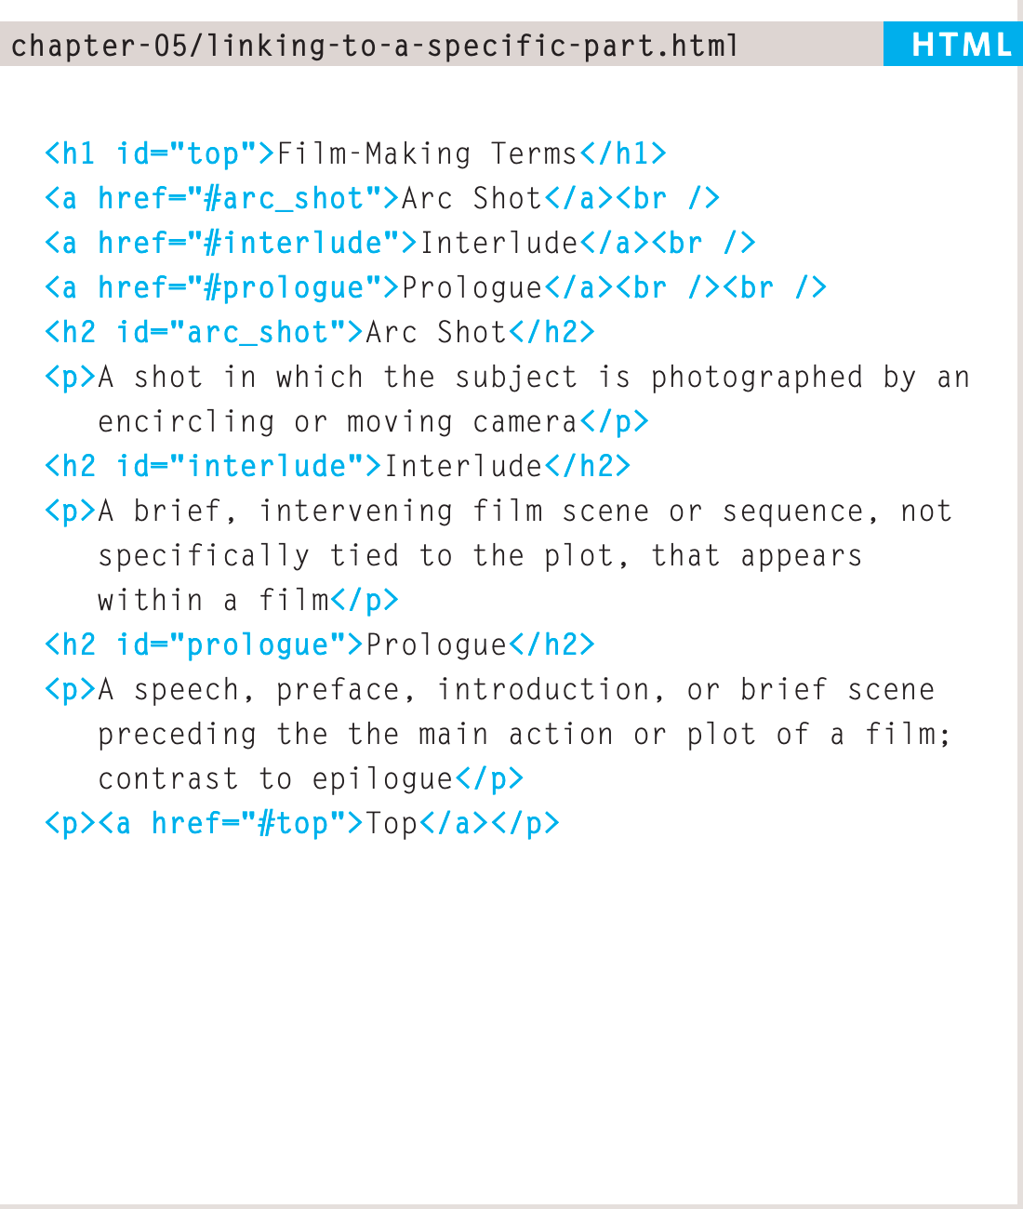
Links
Before you can link to a specific part of a page, you need to identify the points in the page that the link will go to. You do this using the id attribute (which can be used on every HTML element).
You can see that the <h1> and </h1> elements in this example have been given id attributes that identify those sections of the page.
The value of the id attribute should start with a letter or an underscore (not a number or any other character) and, on a single page, no two id attributes should have the same value.

Slide 20
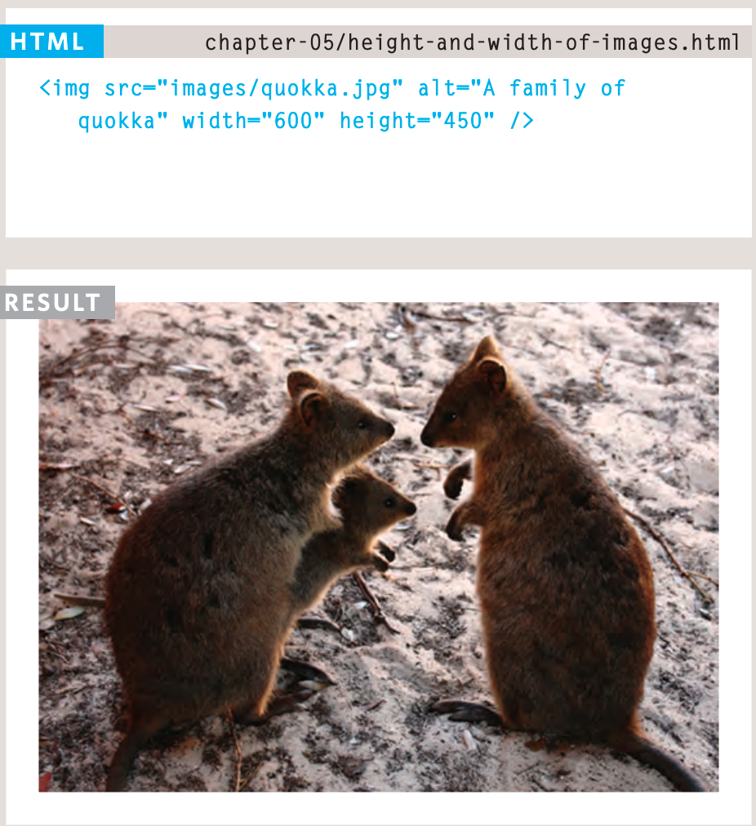
Images
You will also often see an <img> element use two other attributes that specify its size: height This specifies the height of the image in pixels. width This specifies the width of the image in pixels.

Slide 21
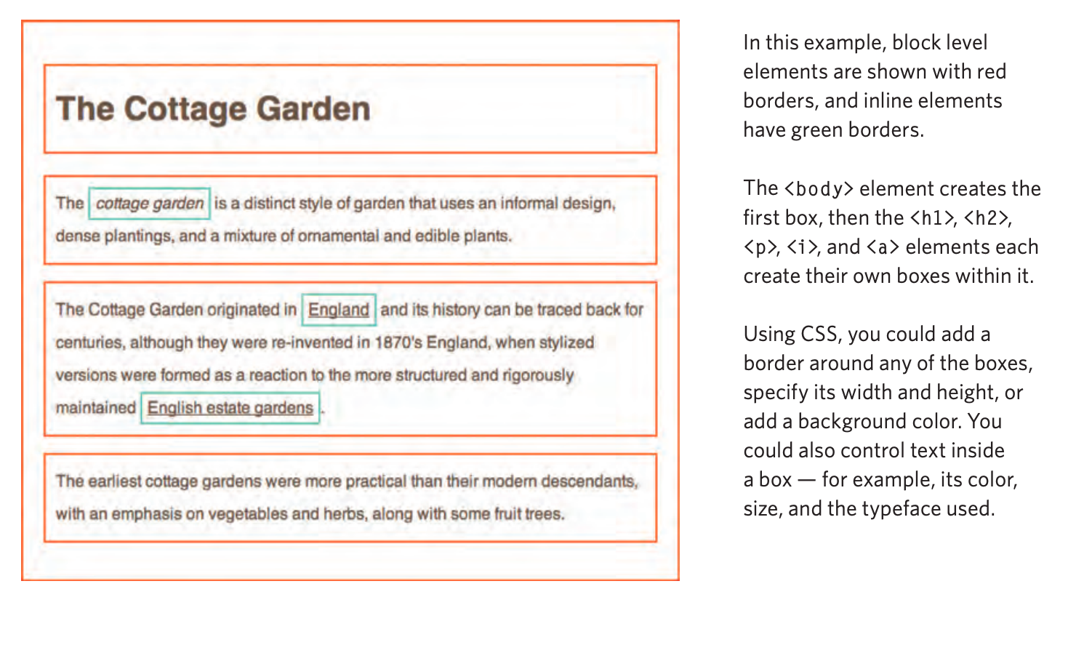
Understanding CSS: Thinking Inside the Box
The key to understanding how CSS works is to imagine that there is an invisible box around every HTML element.
CSS allows you to create rules that control the way that each individual box (and the contents of that box) is presented.

Slide 22
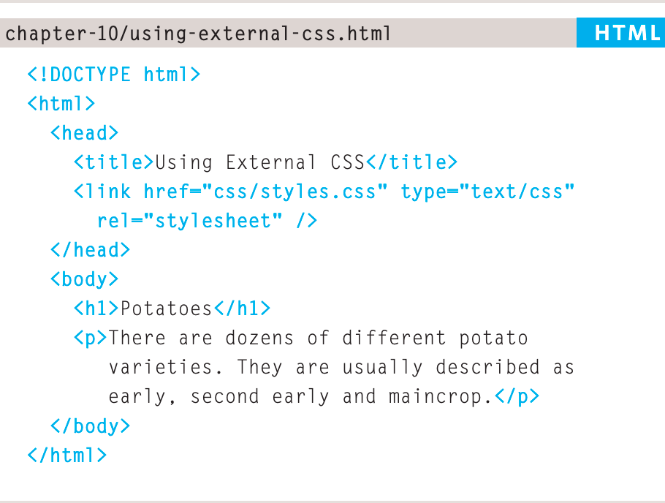
Using external CSS
The <link> element can be used in an HTML document to tell the browser where to find the CSS file used to style the page. It is an empty element (meaning it does not need a closing tag), and it lives inside the element. It should use three attributes:
Href: This specifies the path to the CSS file (which is often placed in a folder called css or styles).
Type: This attribute specifies the type of document being linked to. The value should be text/css.
Rel: This specifies the relationship between the HTML page and the file it is linked to. The value should be stylesheet when linking to a CSS file.

Slide 23
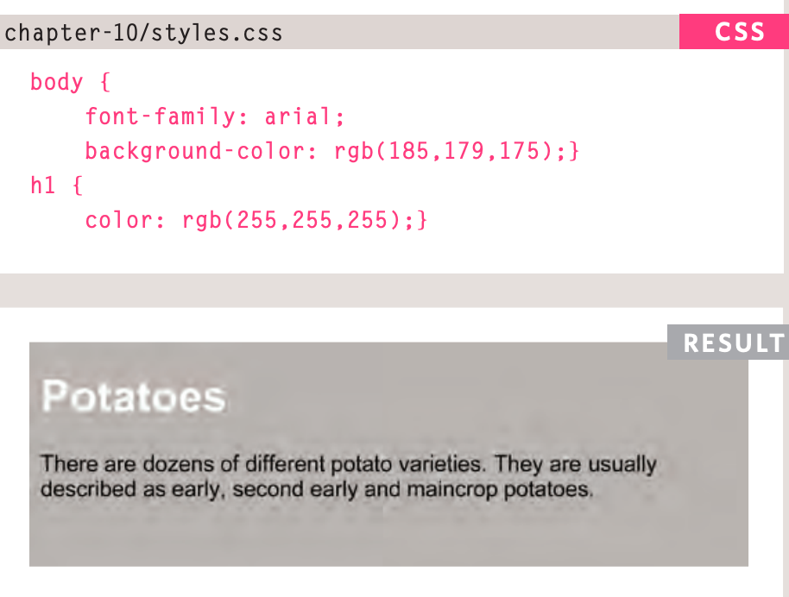
Using external CSS

Slide 24
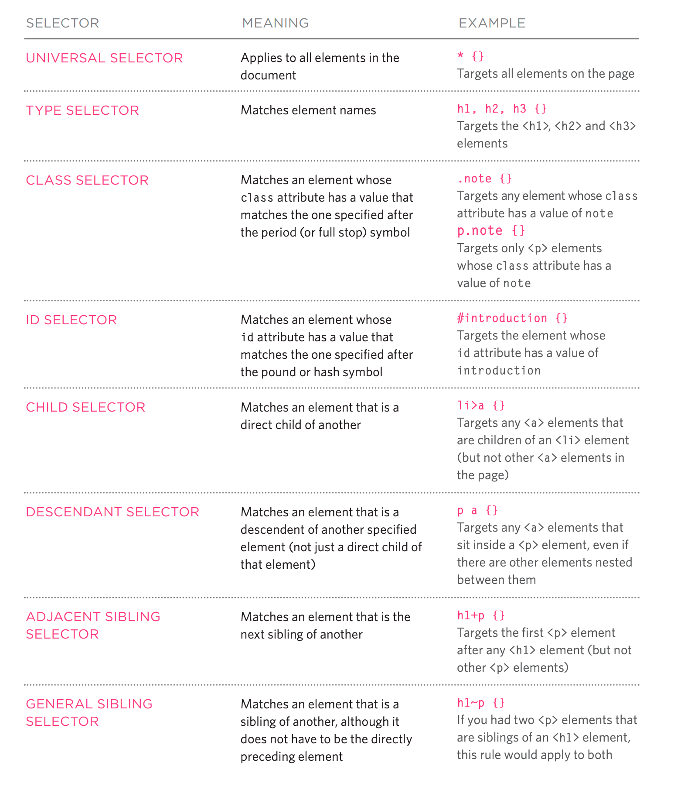
Using external CSS

Slide 25
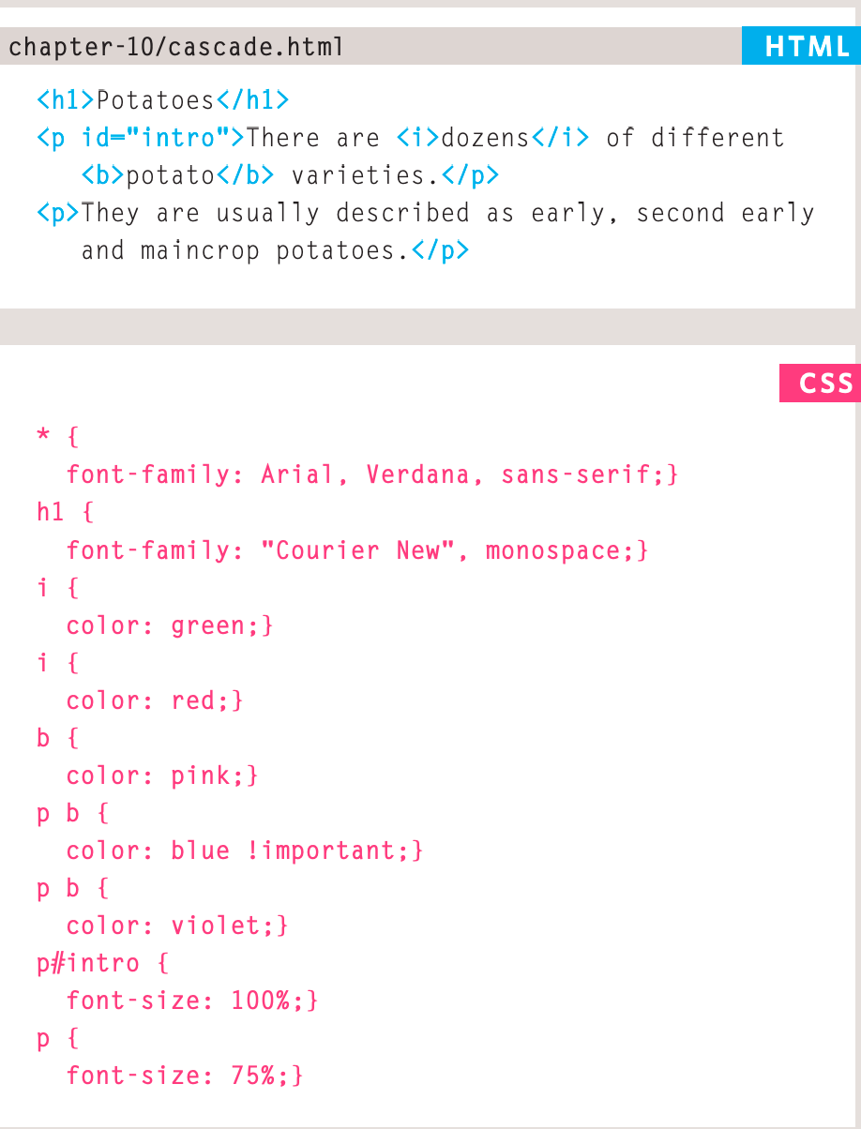
Using external CSS

Slide 26
Some properties CSS
display: flex;
flex-direction: column;
justify-content: center;
align-items: center;
font-family: Source serif Pro
text-align: center;
padding: 5px 20% 0px 20%;

Slide 27
PSet_001
Build a web page like medium one using the tools you saw during the presentation
https://towardsdatascience.com/the-math-behind-neural-networks-a34a51b93873#2077

Slide 28
www.wizeline.com
proprietary + confidential

